Slide 2
.NET 7, Docker, K8S and Azure DevOps

Slide 3

Who am I
Vahid Farahmandian
International Speaker, Author
CEO @ Spoota Co.

Slide 4
Creating/Running ASP.NET Core Sample Project
dotnet new webapp --framework "net7.0" -o "Sample" --language "C#"
console
wpf
xunit
web
mvc
angular
react
webapi
grpc
…
C#
VB
F#
dotnet run --project "Sample/Sample.csproj“
net5.0 - Target net5.0
net6.0 - Target net6.0
net7.0 - Target net7.0
netcoreapp2.1 - Target netcoreapp2.1
netcoreapp3.1 - Target netcoreapp3.1
dotnet publish Sample/Sample.csproj -c release

Slide 5
Dockerize an ASP.NET Core application
Create a Dockerfile for an ASP.NET Core application
Build app inside the docker container
Build app outside the docker container
Method 2 is much faster, as all the artifacts are built outside of the docker build step &
Size of the base image is much smaller compared to the build base image.
Container Registry
Container Repository
Container Image Name
Tag
FROM mcr.microsoft.com/dotnet/aspnet:7.0
COPY bin/Release/net7.0/publish/ App/
WORKDIR /App
ENTRYPOINT ["dotnet",“Sample.dll"]

Slide 6
Dockerize an ASP.NET Core application
Build the Docker image
docker build -t mysample -f Dockerfile .
Run the Docker image
docker run -d -p 8080:80 --name mysampleContainer mysample
View the web page running from a container
Image Name
Path to Dockerfile
Run container in background
Connect externalPort:internalPort
Container Name
Image Name

Slide 7
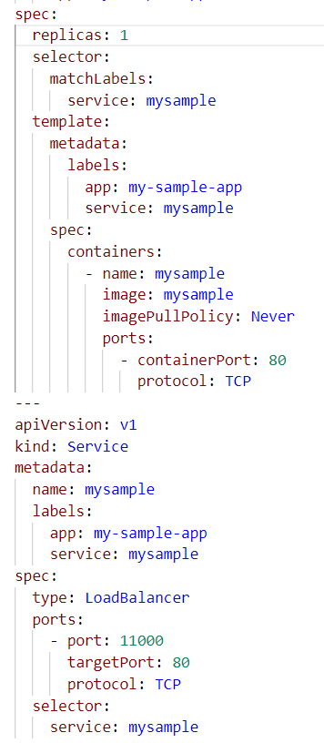
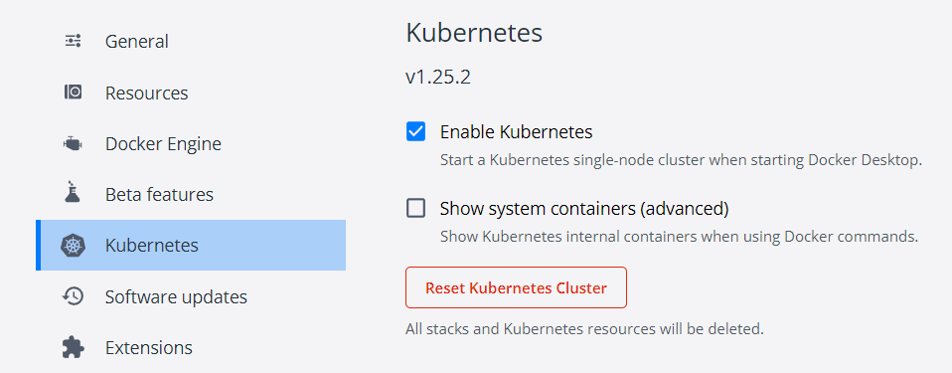
Deploy on kubernetes
Number of replicas
Enable Kubernetes in Docker Desktop
Create a file defining Kubernetes resources
Create and update resources
Kubectl apply –f k8s.deploy.yaml
Container Name
Image Name
Port mapping

Slide 8
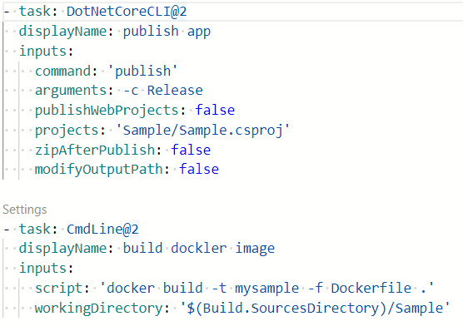
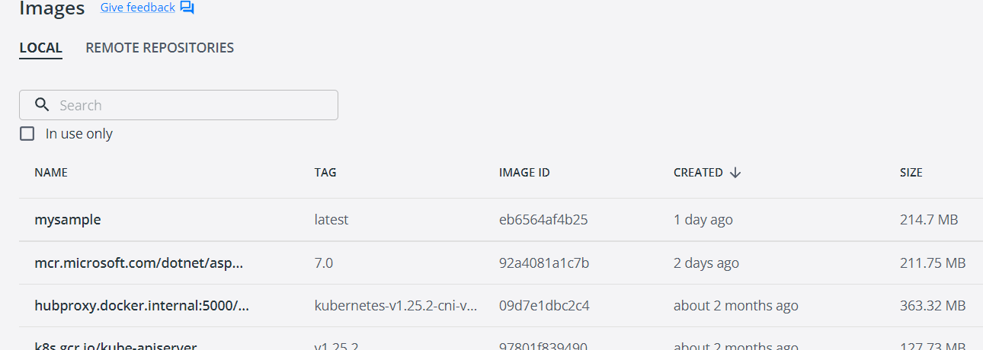
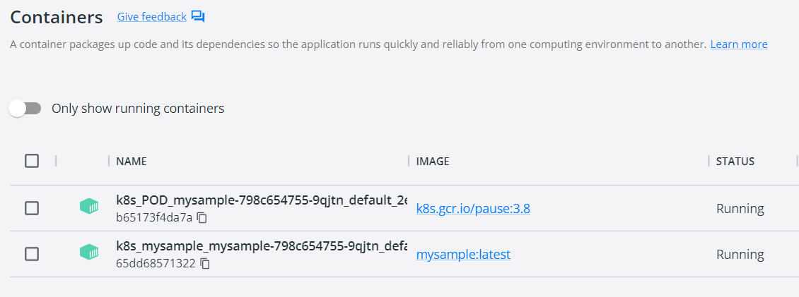
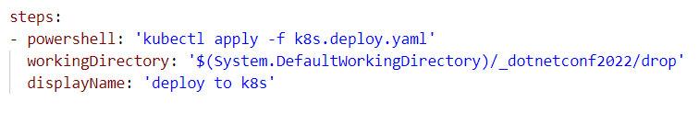
CI/CD Pipelines in Azure DevOps
Create build pipeline
Create release pipeline
Publish app outside the docker image
Image created by CI pipeline
Build docker image
Container created by CD pipeline

Slide 9
Further works
You might need to use:
private/public docker registry
Kubernetes namespaces
Azure Kubernetes Service (AKS)
multistage pipelines
Clone source code: https://dev.azure.com/farahmandian/_git/dotnetconf2022
https://github.com/VahidFarahmandian/dotnet7-docker-k8s

Slide 10
Contact me
Email: farahmandian2011@gmail.com
Twitter: _jinget
GitHub: VahidFarahmandian
Instagram: VahidFarahmandian
LinkedIn: Vfarahmandian
YouTube: Jinget dot Net

